Slide 1
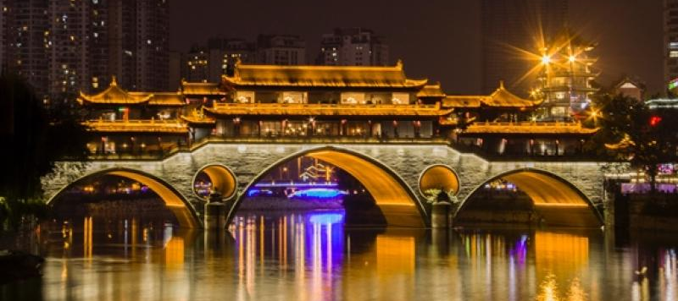
Smile Train travel scholarships for young researchers from LMICs* working on oral health inequalities
GOHIRN is very happy to announce that Smile Train will provide 10 travel scholarships of US$2,000 each for GOHIRN members from LMICs* to attend the next IADR general meeting. Those who are not current IADR/GOHIRN members are also eligible
as IADR membership costs will be covered as well!
Please note that to apply for the scholarship, your abstract must be accepted for presentation at the IADR general meeting
2022 IADR/APR General Session & Exhibition, June 20-25, 2022
Chengdu, China & Online
Deadline for abstract submission: January 17, 2022
https://www.iadr.org/2022iags/abstract--session-proposals#
*Low and Middle Income Countries

